Slide 1
Learning and Teaching Symposium 2018 Learn to Code Westminster Teaching Excellence Team Award 2018
Anne-Gaelle Colom - Senior Lecturer, Leader of the Learn to Code Community, SFHE. Dep. of Computer Science
Wendy Purdy - Senior Lecturer, Member of the Learn to Code Community, SFHE. Dep. of Computer Science

Slide 2
Structure of Presentation
The problems we wanted to address.
Phase one: real-time code visualiser.
Introduction and Demo
Phase two: Lessons and videos to support learning of key programming concepts.
Introduction and Demo
Phase three: Cross-disciplinary collaboration.
Discussion

Slide 3
The problems we wanted to address
Computer Programming is a key skill requirement for all students on our department’s UG courses.
Our large cohort (300+ L4) start with a diverse range of entry qualifications, competencies, educational experiences and learning styles.
Some students find programming hard!
Could we develop a digital learning resource to support independent learning and inclusion?

Slide 5
Code
Abstract
Very quickly becomes unreadable
Language as barrier when introduced
Current teaching methods of programming not suited to the visual and kinetic learners
Gender gap: women are creative programmers, men are formal programmers.

Slide 6
Code
Instructions

Slide 7
Instructions
Gå mot norrut
Gå mot norrut på Regent St/A4201 mot Great Castle St

Slide 8
Instructions

Slide 9
Is the language still a barrier?

Slide 10
Phase One
Phase One: real-time code visualiser.
Analyses code entered by the student and shows graphically in real-time the flow of the code.
It enhances learning by enabling students to view a graphical representation of their code, thereby understanding how code flows.
Students are able to modify the content and view graphically the effect of the programmed manipulation

Slide 11
if… else
if ( A ) {
B
} else {
C
}

Slide 12
Phase One

Slide 13
Tool development
FST Sabbatical: January to July 2016
Web-based
Produces animatable SVG

Slide 14
Demo Time…
Notes:
Lecture, video, code visualiser, array visualiser
if, if else, if else if , while, do while, for loops, switch case, functions calls
features: real-time, zoom in/out, pan zoom in/out, save code, upload code, download graph

Slide 15
Stage One: real-time code visualiser
Anne – Winner of the WISE International Open Source Award November 2016

Slide 16
We can
Make programming accessible to a wider community

Slide 17
We can
Help students embrace and enjoy programming

Slide 18
Phase Two
Phase two: Lessons and videos to support learning of key programming concepts.
Each lesson is available in all of the three core programming languages taught at Level 4.
Student selects which language to be shown by default.
Student can switch between the programming languages to compare syntax differences.
An enhanced comparison feature shows code examples for selected languages adjacent to each other.
Student can experiment with the lesson code in an interactive area and view code structure in the visualiser.
We also provide demonstration videos.

Slide 19
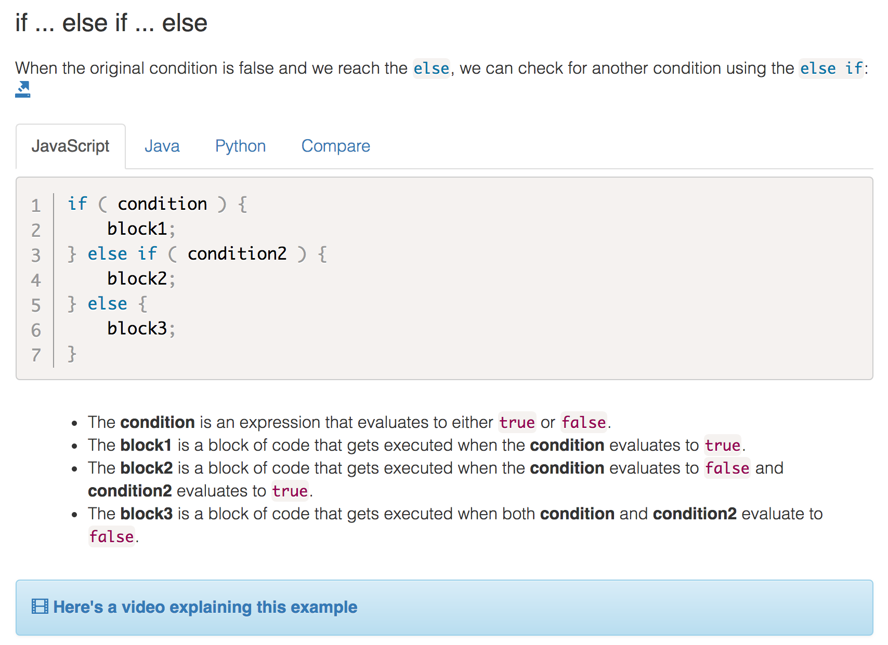

Slide 20
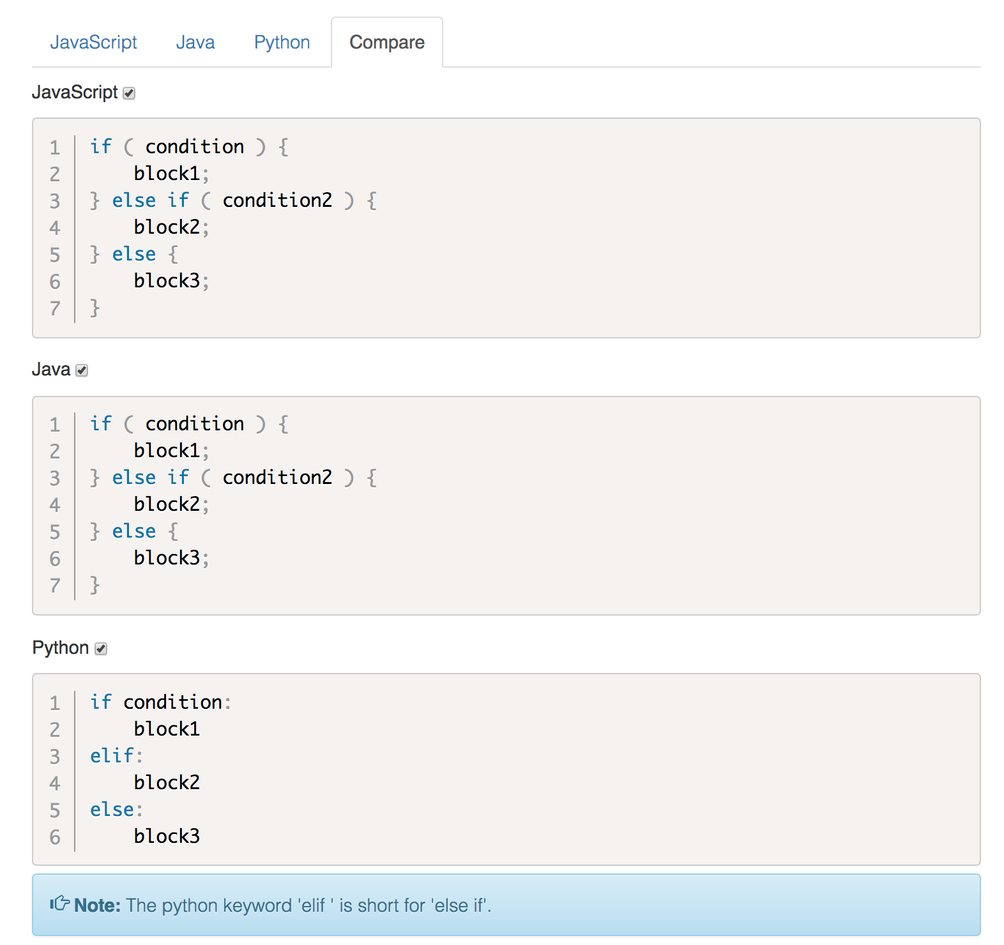

Slide 21
Demo Time…
Notes:
Lecture, video, code visualiser, array visualiser
if, if else, if else if , while, do while, for loops, switch case, functions calls
features: real-time, zoom in/out, pan zoom in/out, save code, upload code, download graph

Slide 22
Where are we now?
Stage two
Extended collaboration between staff (design and development).
Extended collaboration between staff and students (testing and development).
Additional lessons and demonstration videos required.
Will be incorporated into Level 4 core programming modules from the 2018-19 academic session.
Review progress rates with previous years to measure the possible impact on diversity / inclusion
Review Instructor and Student feedback

Slide 23
Availability
Available to the UOW:
http://learntocode.westminster.ac.uk/index.php
Available to other institutions (Academic License)
Moving to Open Source release
get students as co-creators
get a world-wide community of contributors and users

Slide 24
Stage Three
Strand A - Students as co-creators
student can contribute code to lessons or code visualiser
Strand B - Cross-disciplinary collaboration
same styling of presenting concepts
Anything else?? - Discussion

Slide 25
Let’s expand this Team!!!

