Slide 1
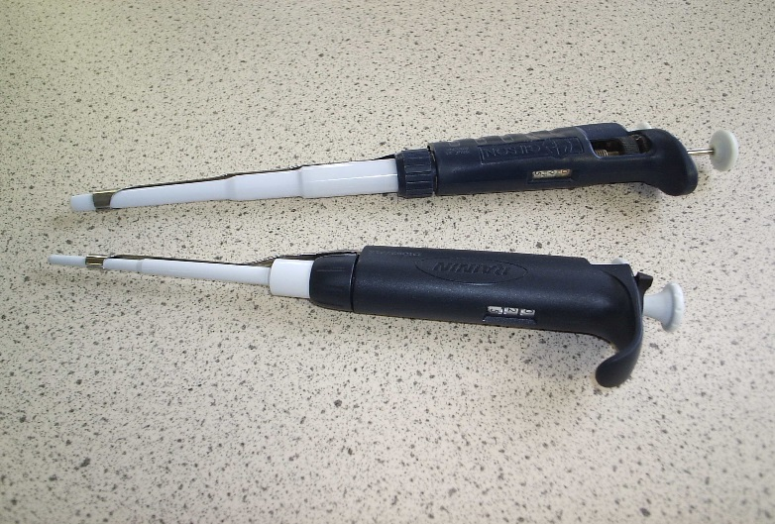
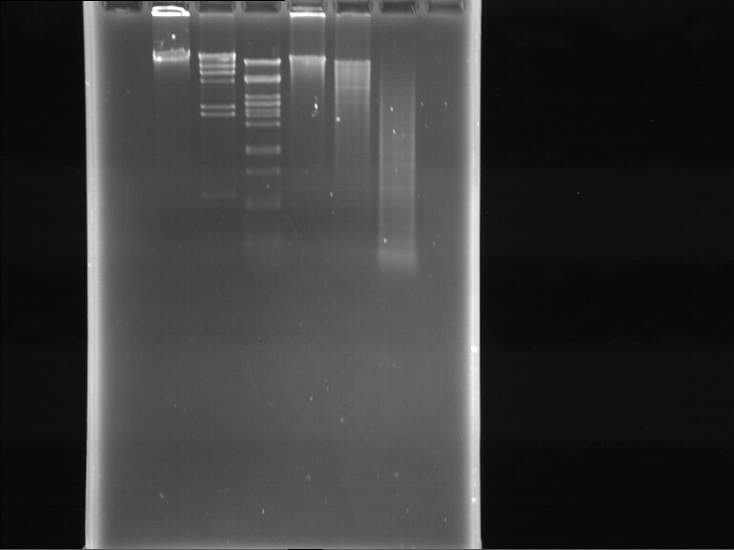
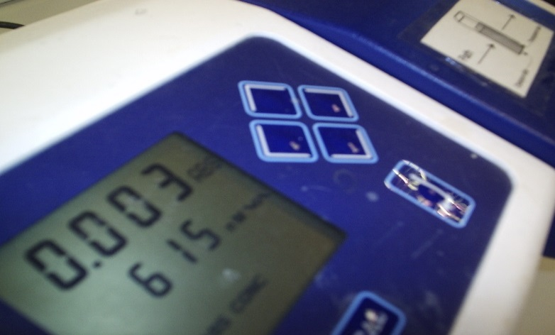
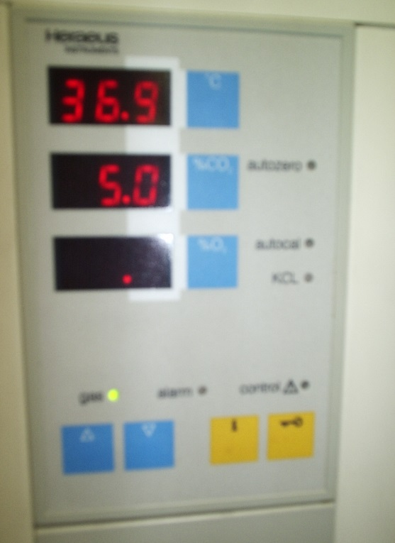
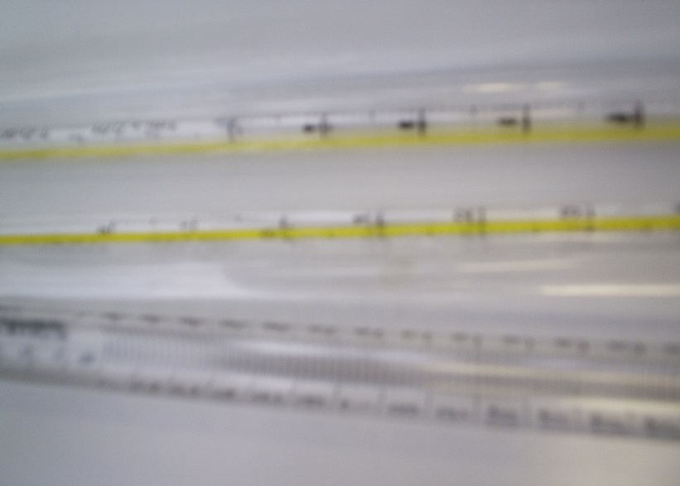

Inclusive and Interactive Mathematics Support for the Biosciences
Chrystalla Ferrier and Paul Curley
Notes:
Some maths is required for all HE science

Slide 2

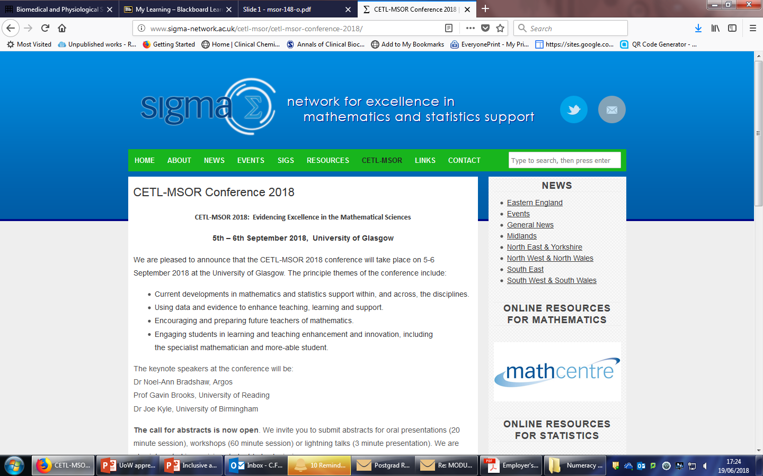
Background
Mathematics support
Biomaths Landscape
Support sessions and resources for Biomedical Science and Life Science students have been available at the
University of Westminster since October, 2012.
Notes:
Background studies, also discuss maths anxiety and employer requirements

Slide 3
What we do
Advertising and availability of resources on core Level 4 modules (Biochemistry and Critical Skills for the Biomedical Sciences)
Available to all students
Optional self- assessment test
Sign up for face-to-face drop-in sessions
Permanent availability of resources
Some bespoke sessions offered to small groups of students e.g. Foundation Year

Slide 4
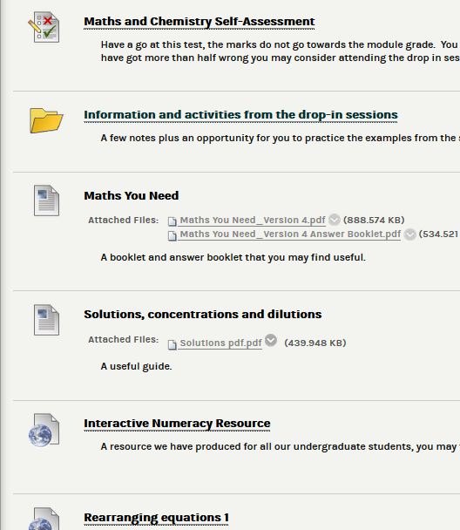
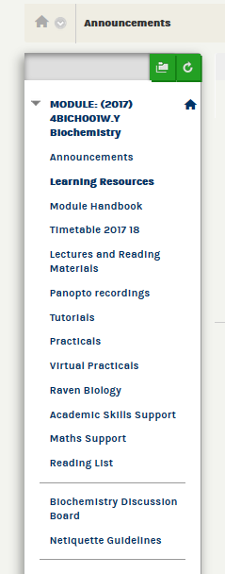
Blackboard presence
Notes:
Session timing aligned to module assessment deadlines

Slide 5
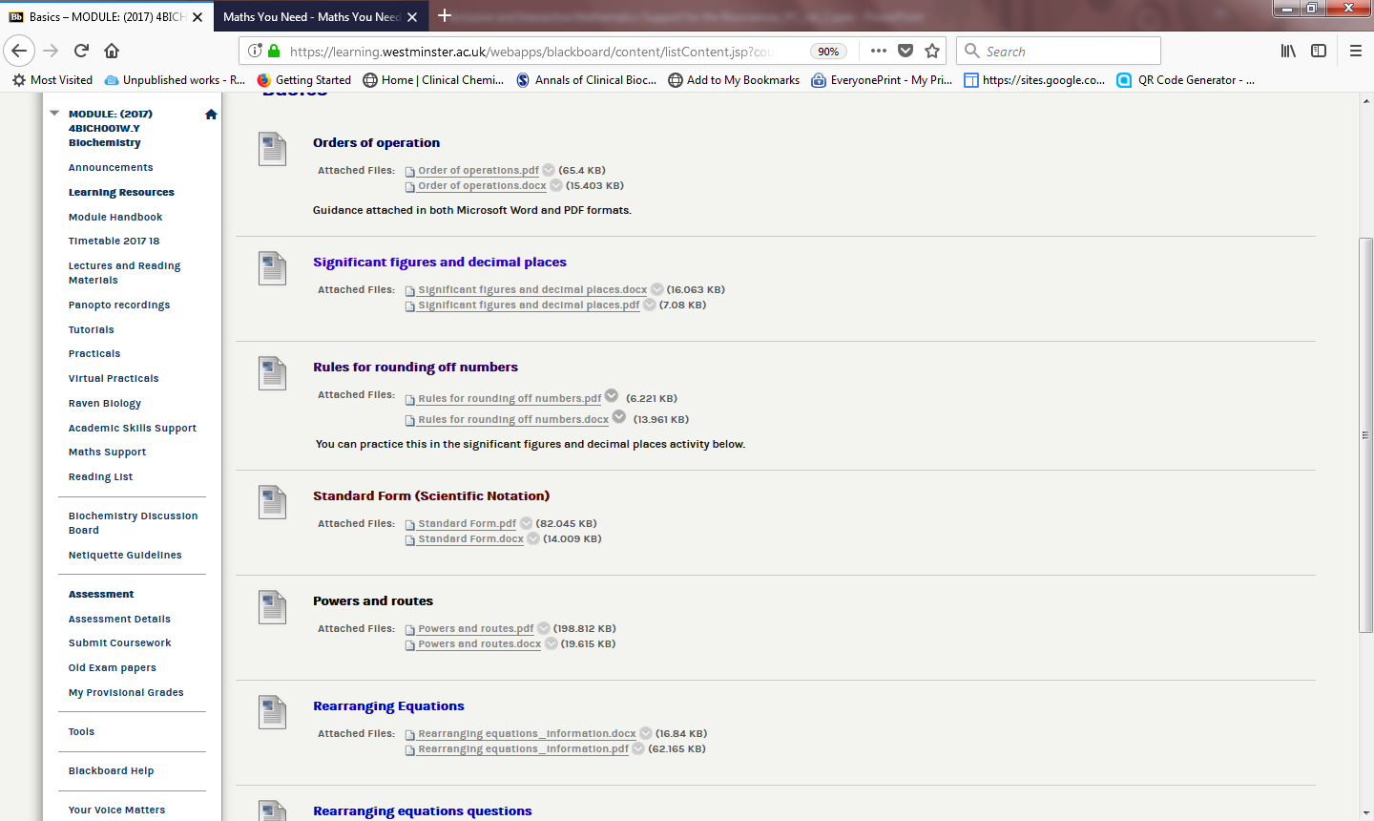

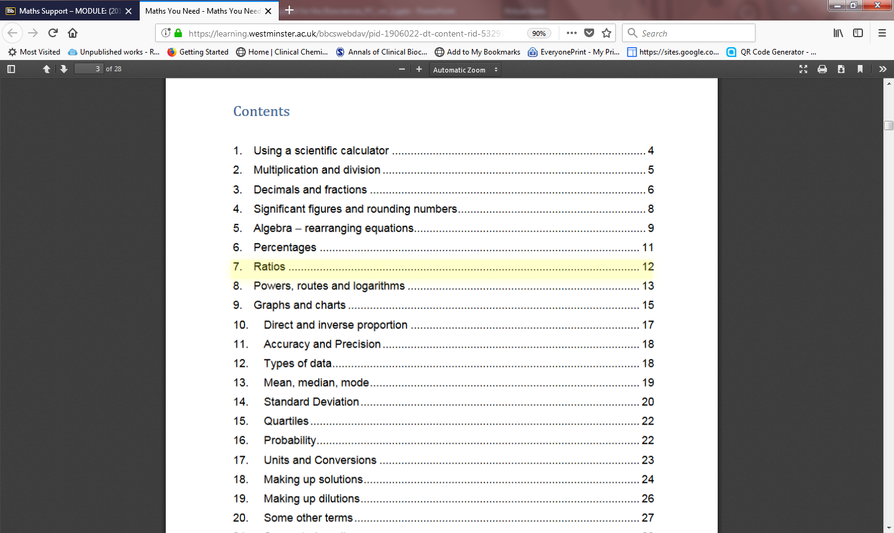

Slide 6
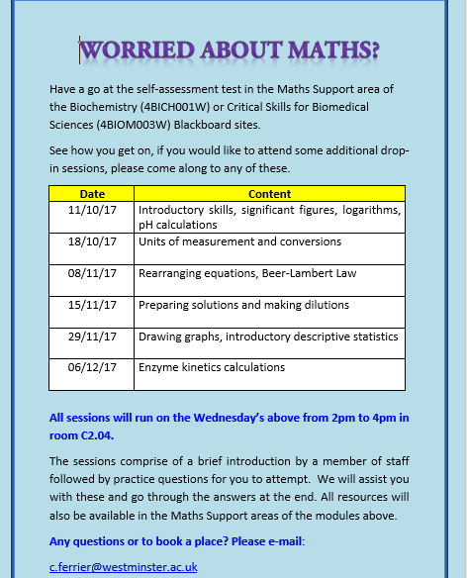
Drop-in Sessions Timetable

Slide 7
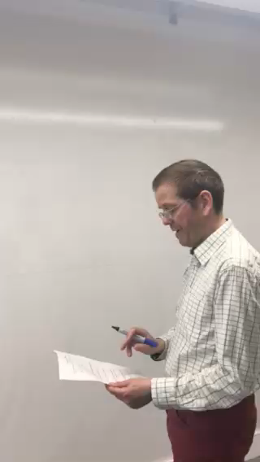
Drop-In Sessions

Slide 8
2017-2018 Uptake and Feedback
36 students signed up to attend some or all of the sessions
Students were from Biochemistry, Biological Sciences, Biomedical Sciences, Herbal Medicine, Human Nutrition and Pharmacology & Physiology
Entrance mathematics qualifications ranged from A to D at GSCE (D overridden by Level 3 qualification)
Post-GCSE qualifications included A levels, BTEC, Access courses as well as a number of overseas qualifications
Recent school leavers and mature students

Slide 9
22 students responded to a Google Form anonymous survey
Survey questions

Slide 10
1. Awareness of resources?
Biochemistry and Critical Skills for Biomedical Sciences modules

Slide 11
Resources used

Slide 12
Not using any/some of the resources?
“I was not informed that there were any resources available.”
“Needed to review and improved some of my math skills, I finish my studies in humanities long ago.”
“I am confident with my mathematical skills.”
“I have not needed to use them yet, but may possibly need them in the future.”
“I am now using the ones I haven't used. I couldn't keep up.”

Slide 13
On a scale of 1 – 5 (5 being the most useful) 70% of students using the Blackboard resources scored 5/5, 20% 4/5 and 10% 3/5.
The same pattern was observed when asking students about the individual topics covered in the sessions, no session was found to be of limited use by any of the students.

Slide 14
Suggestions for improvements?
“I think giving out optional home work out to students will be very helpful.”
“If it's possible to include one or two chemistry lessons.”
“The times for the drop in sessions clashed with my practicals and tutorials.”
“Perhaps provide more time options for classes that will teach the same subject. For example one during the day one in the afternoon and one in the evening for those who are not able to make it to the previous lessons.”
“I really loved them. No improvement required.”

Slide 15
Suggestions for improvements?
“Add physiology/anatomy drop in sessions.”
“Drop in sessions nearer to the exams.”
“Could the times and dates of what is being covered be made available to everyone, even if you were unable to make the first session? As some people may only need help with specific areas.”

Slide 16
Good Practice
Make students comfortable!!
We have a non-judgemental approach, encourage questions, have no in-class testing, are flexible with content and have enough staff for one-to-one help.

Slide 17
Conclusions
Maths support continues to be well received and attract students from a selection of courses and with a range of higher education entrance qualifications
The main aim is to provide relaxed and enjoyable support relevant the courses and overcome any ‘maths anxiety’
Timetabling aims to suit all but is still not always convenient for some
Some additional alignment to core module assessments is planned for 2018/19

Slide 18
Should there be a University-wide Maths Support Centre?

